Slide 1
Planet Savers: Innovation in Waste Management
By Jane Muthoni Ndung'u
REG NO: C026-01-1012/2021

Slide 2
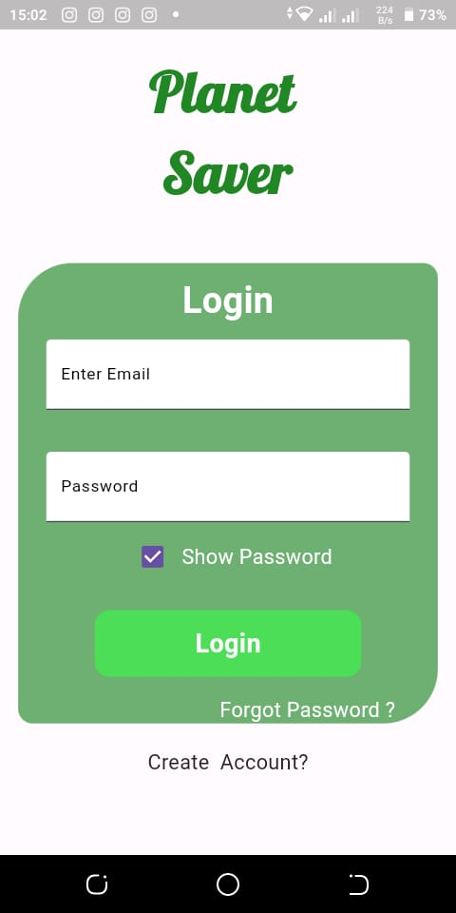
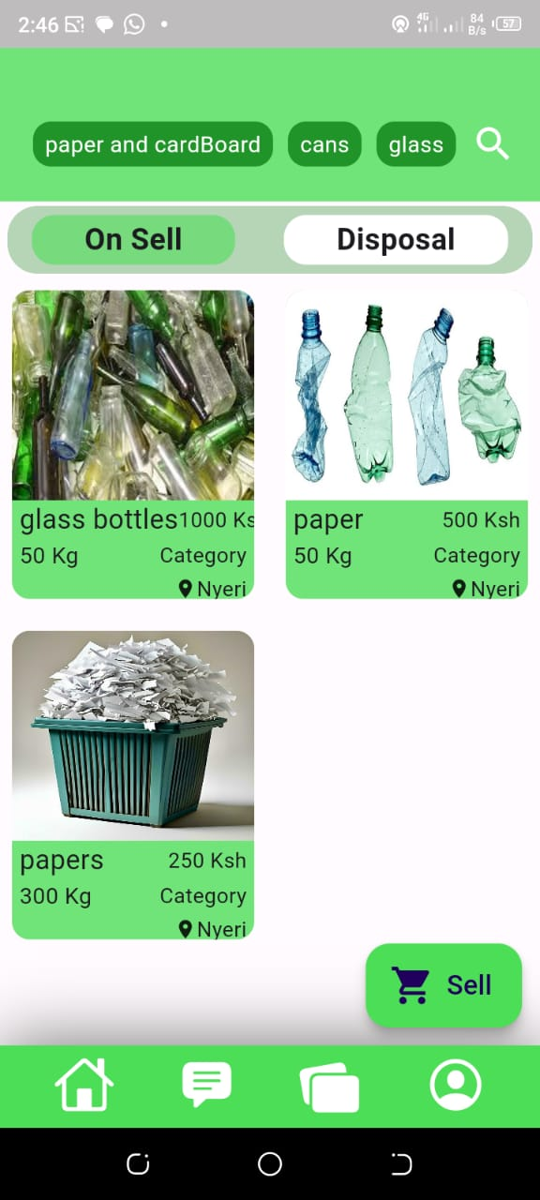
SAMPLE UI

Slide 3
Introduction
Overview of the Planet Savers project and its significance in waste management.

Slide 4
Problem Statement
Current waste management challenges:
- Increasing waste generation
- Limited recycling and disposal options
- Environmental impact and health concerns

Slide 5
Project Objectives
Primary objectives of the Planet Savers project:
- Reduce waste generation
- Improve recycling rates
- Minimize environmental impact

Slide 6
Innovation in Waste Collection
Implementation of smart bins:
- Sensor technology for waste level detection
- Data collection and analysis for efficient waste collection routes

Slide 7
Recycling and Reuse
Advanced recycling techniques:
- Segregation at source
- Use of automated sorting systems
- Promoting reuse and upcycling of materials

Slide 8
Community Involvement
Engaging the community:
- Educational campaigns
- Incentive programs for recycling participation
- Collaborations with local organizations

Slide 9
Technology Integration
Leveraging technology for waste management:
- Mobile apps for waste tracking
- Online platforms for waste exchange
- Blockchain for transparent waste management

Slide 10
Pilot Project
Details of the pilot project:
- Location: Thika
- Duration: 6 months
- Key activities and expected outcomes

Slide 11
Data Collection and Analysis
Methods for data collection:
- Sensor data from smart bins
- Surveys and community feedback
- Analysis techniques for improving waste management practices

Slide 12
Environmental Impact
Positive environmental outcomes:
- Reduction in landfill waste
- Decrease in pollution levels
- Conservation of natural resources

Slide 13
Economic Benefits
Economic advantages of the project:
- Cost savings in waste management
- Creation of green jobs
- Revenue generation from recycled materials

Slide 14
Challenges and Solutions
Addressing potential challenges:
- Public resistance to change
- Technical issues with smart bins
- Solutions and contingency plans

Slide 15
Partnerships and Collaborations
Collaborative efforts:
- Partnerships with local governments
- Collaborations with private companies
- Engagement with NGOs and community groups

Slide 16
Sustainability Plan
Ensuring long-term sustainability:
- Continuous improvement strategies
- Regular monitoring and evaluation
- Scaling the project to other regions

Slide 17
Future Innovations
Exploring future possibilities:
- Integration of AI and machine learning
- Development of circular economy models
- Innovations in waste-to-energy technologies

Slide 18
Project Timeline
Detailed project timeline:
- Planning phase
- Implementation phase
- Monitoring and evaluation phase

Slide 19
Budget and Funding
Financial aspects:
- Budget breakdown
- Funding sources
- Financial sustainability of the project

Slide 20
Impact Assessment
Measuring project impact:
- Key performance indicators
- Short-term and long-term impact
- Reporting and transparency

Slide 21
Conclusion
Summary of the Planet Savers project:
- Innovation in waste management
- Positive environmental and economic impact
- Future vision for sustainable waste management
- Thank you for your attention.

